Slide 1
Machine Learning
Part II

Slide 2
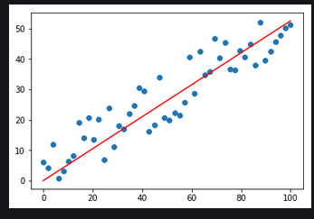
Case Study: Time Series and Simple Linear Regression
Simple linear regression is the simplest regression algorithm
regression line - is simply a single line that best fits the data (in terms of having the smallest overall distance from the line to the points).

Slide 3
Case Study: Time Series and Simple Linear Regression
Using a time series of average New York City January high-temperature data for 1895 through 2018
Perform simple linear regression
Display a scatter plot with a regression line
Use the coefficient and intercept values calculated by the estimator to make predictions

Slide 4
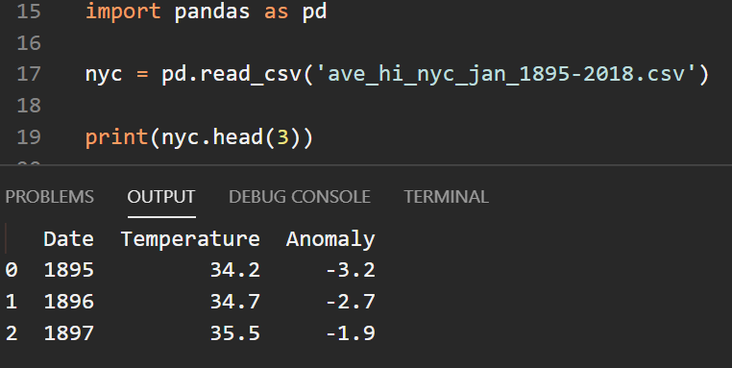
Loading the Average High Temperatures into a DataFrame
Read the csv file into a dataframe and display the first 3 samples

Slide 5
Splitting the Data for Training and Testing
use the LinearRegression estimator from sklearn.linear_model
By default, this estimator uses all the numeric features in a dataset, performing a multiple linear regression
We want to perform a simple linear regression using just one feature (column/attribute) as an independent variable. We will use the feature - Date
A column in DataFrame is a one-dimensional Series
Scikit-learn estimators require training and testing data to be two-dimensional
transform Series of n elements, into two dimensions containing n rows and one column

Slide 6
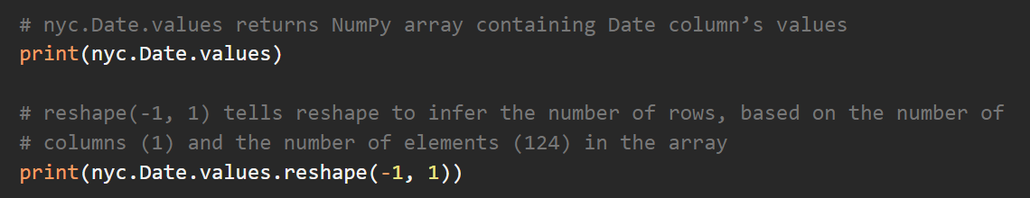
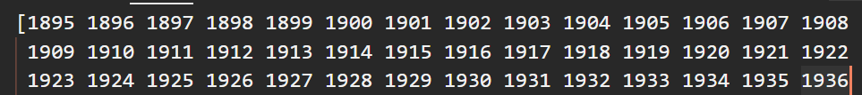
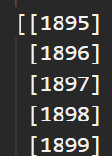
Splitting the Data for Training and Testing

Slide 7
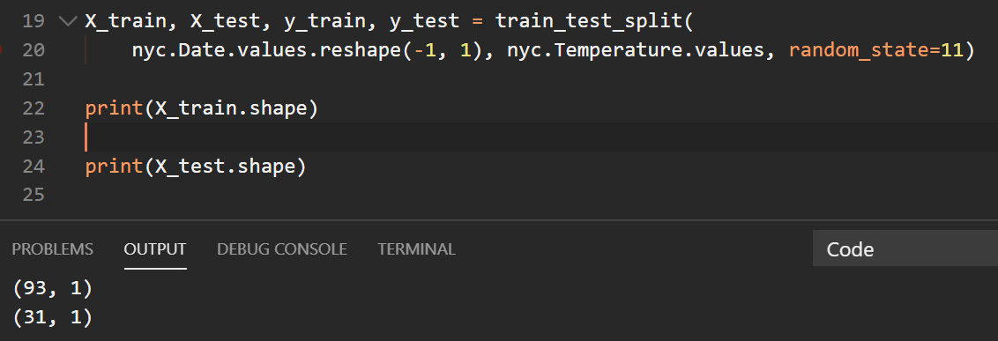
Splitting the Data for Training and Testing
Transformed array will have 124 rows and one column
75% will be for training
25% will be for testing

Slide 8
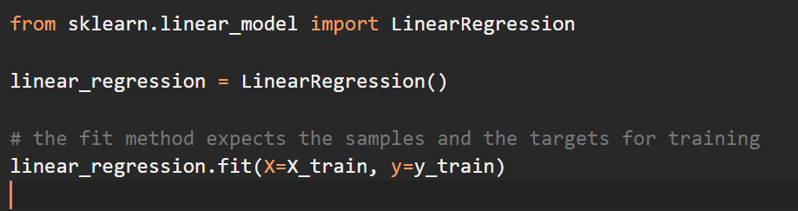
Training the model
To find the best fitting regression line for the data, the LinearRegression estimator iteratively adjusts the slope and intercept to minimize the sum of the squares of the data points’ distances from the line

Slide 9

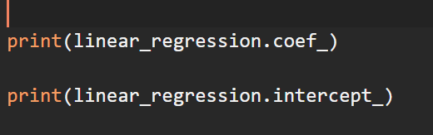
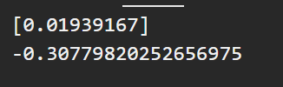
Training the model
Using the model for slope and intercept we can make predictions
Slope is the estimator’s coeff_ attribute (m in the equation)
Intercept is the estimator’s intercept_ attribute (b in the equation)

Slide 10
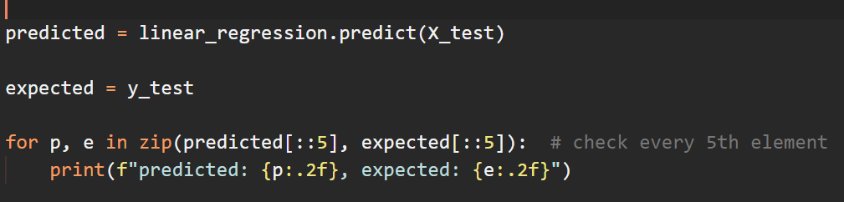
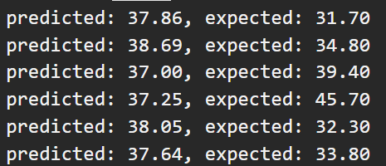
Testing the Model
Test the model using the data in X_test and check some of the predictions

Slide 11
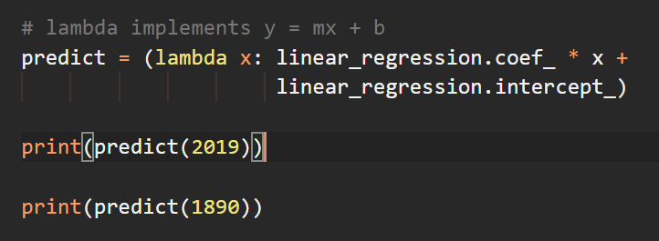

Predicting Future Temperatures and Estimating Past Temperatures
Use the coefficient and intercept values to make predictions

Slide 12
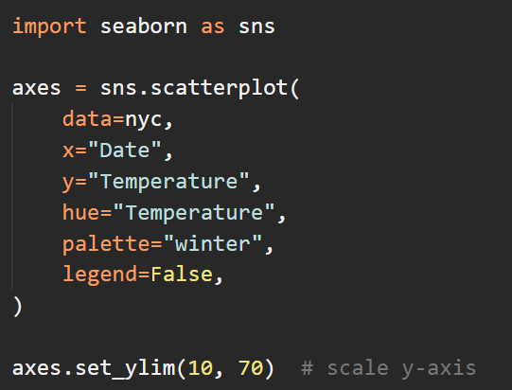
Visualizing the Dataset with the Regression Line
Create a scatter plot with a regression line
Cooler temperatures shown in darker colors

Slide 13
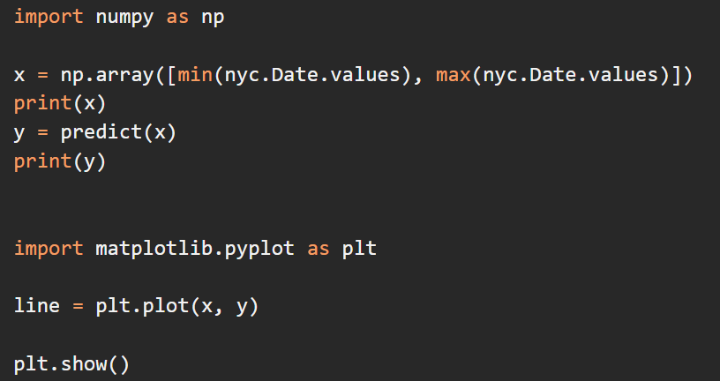

Creating the regression line
create an array containing the minimum and maximum date values in nyc.Date. These are the x-coordinates of the regression line’s start and end points. Using those years we can get the y-coordinates for predicted temperature (using the lambda function)

Slide 14
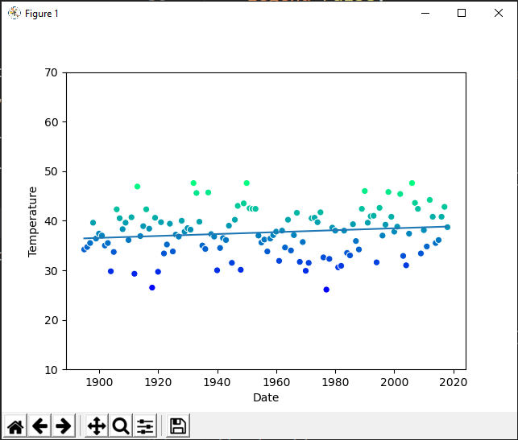
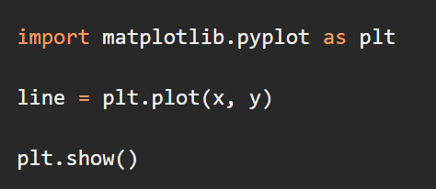
Visualizing the Dataset with the Regression Line
use Matplotlib’s plot function to plot a line based on the x and y arrays, which represent the x- and y-coordinates of the points, respectively:

